Slide 1

Performance Assessment for D210: Representation and Reporting Part 2: Storytelling with Data Christopher Fischer – 011933891 College of Information Technology Western Governors University August 24, 2024

Slide 2
Agenda
Introduction
Problem statement
Data analyzed
Key insights
Recommendations

Slide 3

Introduction
Senior Data Analyst @ Bigtel
25 years in business intelligence
12 years in telco

Slide 4

Problem statement The C-suite and board of directors have expressed concern about high levels of customer churn This study was commissioned to identify potential focus areas to address underlying issues leading customers to churn

Slide 5
Data analyzed
Extract of Bigtel’s Customer Relationship Management (CRM) system
10,000 customer records
Demographics
Subscribed services
Service usage and tenure
Billing and payment details
Third-party dataset on broadband services across the US ¹
Broadband service availability
Number of competitive providers in each zip code
Pricing information
¹ Source: Broadband Now Open Data Challenge. Current as of October 2020. https://github.com/BroadbandNow/Open-Data

Slide 6

Key insights
What do the data show?

Slide 7
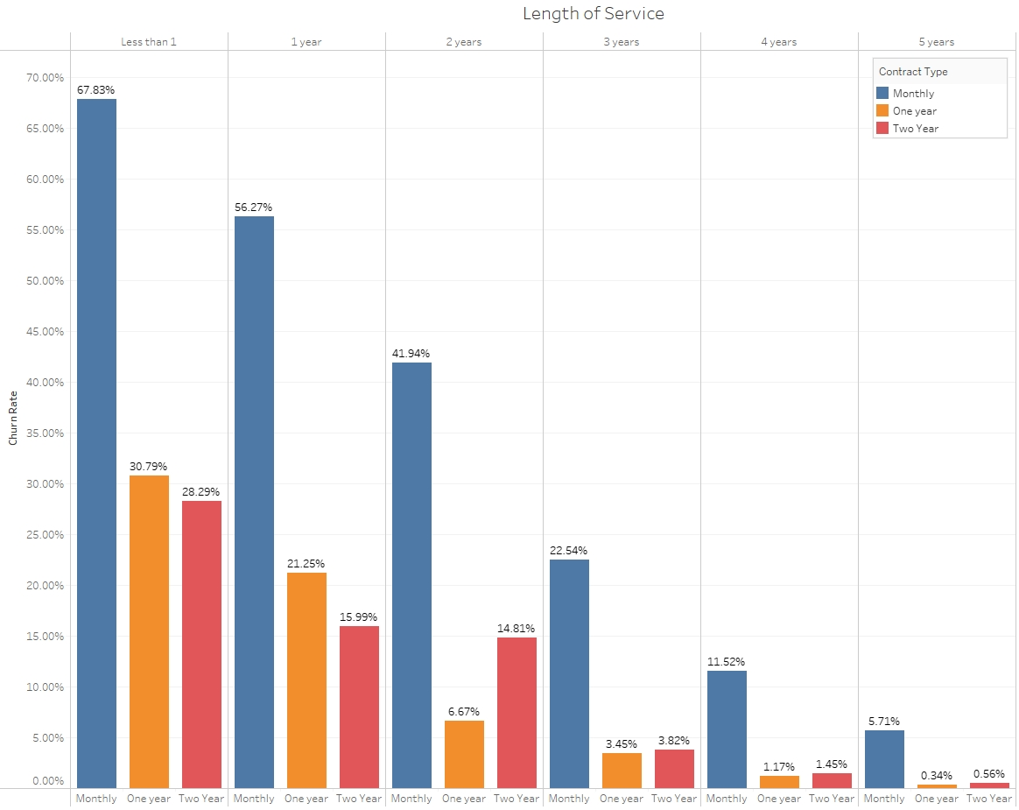
Tenure and Contract Type
The longer we keep a customer, the less likely they are to churn
Customers on a one- or two-year contract are 50-95% less likely to churn across all lengths of service

Slide 8
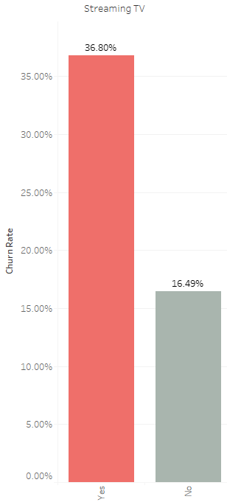
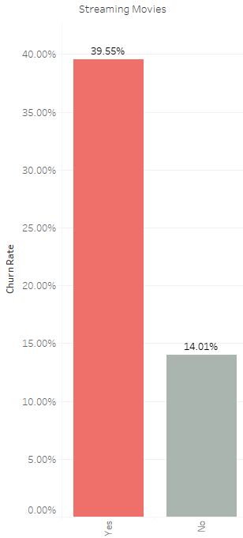
Streaming services
Customers who subscribe to our streaming video services are 2-3x more likely to churn
None of our other service offerings suffer from this degree of correlation

Slide 9
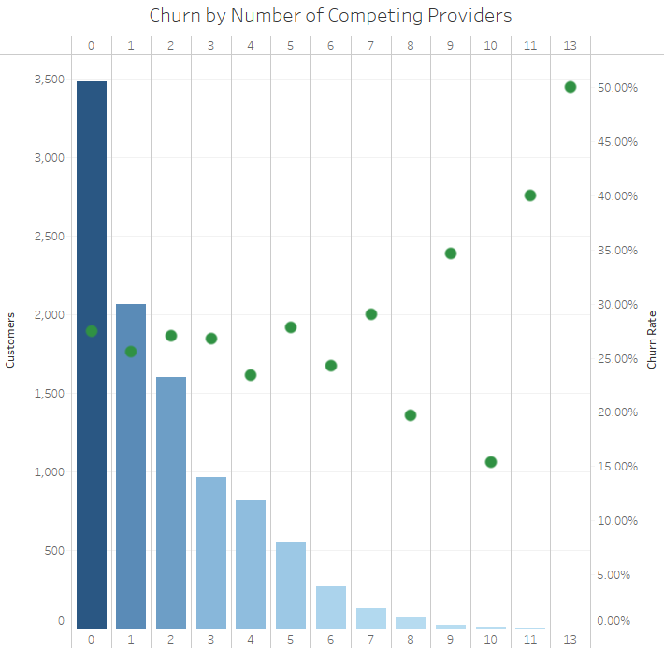
Competitive Alternatives
Customers living in areas with competing broadband service providers are slightly more likely to churn
This may be due to our service pricing. Our customers pay (on average) $117 more per month than the lowest-cost comparable provider in their area

Slide 10

Recommendations
What next?

Slide 11
Actions to take
Insight | Recommendation
Longer tenure | Develop a loyalty program that rewards customers the longer they remain subscribed Earn points that can be used for streaming movie rentals or gift cards One-time discounts as certain milestones are achieved Special recognition banner on the customer profile page
One- and two-year contracts | Create a marketing campaign to promote the benefits of selecting a contract Price predictability Convenience of auto payment and renewal Add special features unique to contract holders Early access to new movies Discounts on device upgrades

Slide 12
For Further Study
Insight | Recommendation
Streaming services | Conduct in-depth customer surveys and interviews to identify areas of dissatisfaction Investigate replacing Bigtel’s streaming services in favor of partnerships with major national streaming providers
Service pricing | Perform comprehensive market analysis to determine how Bigtel’s pricing compares to the competition Focus on areas with the most alternative providers available

Slide 13

Thank you!

